Slide 1
Stress, Health & Coping
Numera Younus

Slide 2
Objectives
Describe stress causes and its physical, psychological, and emotional effects.
Explain lifestyle choices and consequences.
Differentiate between healthy and unhealthy lifestyle.
Elucidate different coping strategies used to reduced stress

Slide 3
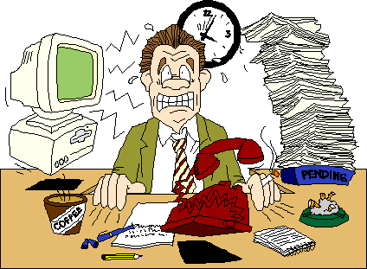
Stress

Slide 4
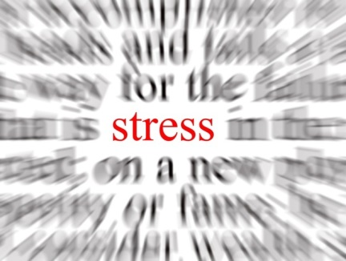
What is Stress?
The collective physiological and emotional responses to any stimulus that disturbs an individual’s homeostasis
A nonspecific, often global, response by an organism to real or imagined demands made on it (a person must appraise a situation as stressful for it to be stressful)

Slide 5
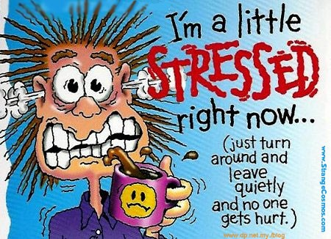
Stressors
Any physical or psychological event or condition that produces stress
Stressors/ causes of stress vary from one person to the next – what is overwhelming to one person may be exciting and challenging to another

Slide 6
Categories of stressors
Cataclysmic stressors
They are strong stressors that occur suddenly and typically affect many people simultaneously. Disasters such as tornadoes and plane crashes as well as terrorist attacks are examples of cataclysmic events that can affect hundreds or thousands of people simultaneously.
Natural disasters VS terrorist attacks

Slide 7
Personal stressors
include major life events such as the death of a parent or spouse, the loss of one’s job, a major personal failure, or even something positive such as getting married. Typically, personal stressors produce an immediate major reaction that soon tapers off. For example, stress arising from the death of a loved one tends to be greatest just after the time of death, but people begin to feel less stress and are better able to cope with the loss after the passage of time.
Some people experience PTSD

Slide 8
Background stressors
Background stressors or more informally, daily hassles, are the third major category of stressors. Exemplified by standing in a long line at a bank and getting stuck in a traffic jam, daily hassles are the minor irritations of life that we all face time and time again. Another type of background stressor is a long-term, chronic problem, such as experiencing dissatisfaction with school or a job, being in an unhappy relationship, or living in crowded quarters without privacy.
By themselves, daily hassles do not require much coping or even a response on the individual’s part, although they certainly produce unpleasant emotions and moods.

Slide 9
The flip side of hassles is uplifts, the minor positive events that make us feel good—even if only temporarily.
They are associated with people’s psychological health in just the opposite way that hassles are: The greater the number of uplifts we experience, the fewer the psychological symptoms we report later

Slide 11
Causes of Stress
Major life changes
Daily hassles
Academic stressors
Interpersonal stressors
Time-related pressures
Financial concerns
Job-related stressors

Slide 12
Causes of Stress
Stressful Life Events
Major life events create stress
Some of the best work on SLE’s was reported by Homes & Rahe (1967)
Ranking of some stressful life events
Top Six |  | Bottom Six
1. | Death of Spouse | 38. | Change in Sleeping Habits
2. | Divorce | 39. | Change in Number of Family Get-togethers
3. | Marital Separation | 40. | Change in Eating Habits
4. | Jail Term | 41. | Vacation
5. | Death of Close Family Member | 42. | Christmas
6. | Personal Injury or Illness | 43. | Minor Violations of Law

Slide 13
Causes of Stress
Frustration
The emotional state or condition that results when a goal – work, family, or personal – is thwarted or blocked
Conflict
The emotional state or condition in which a person has to make difficult decisions about two or more competing motives, behaviors, or impulses

Slide 14
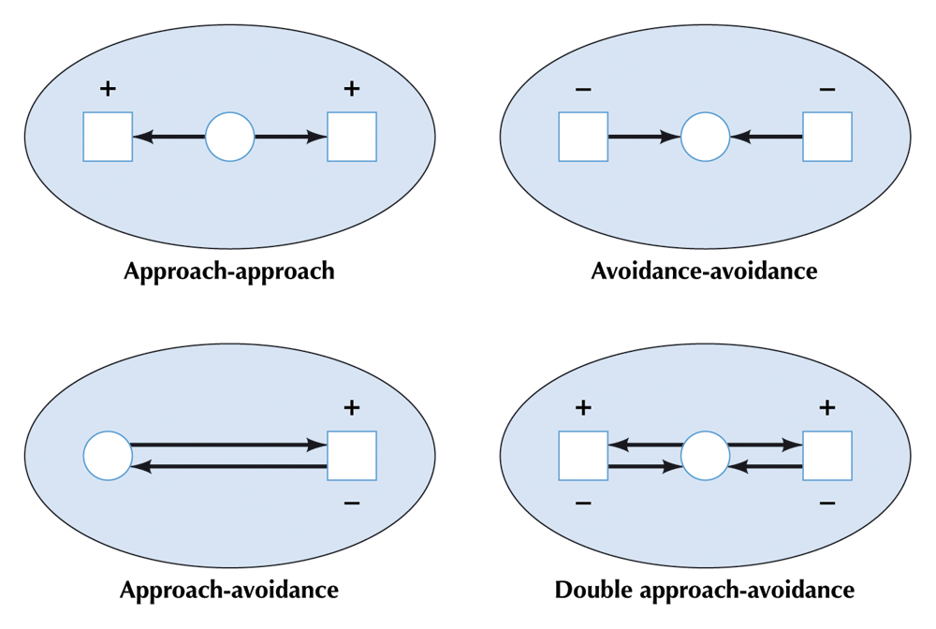
Causes of Stress
Types of Conflict

Slide 15
Approach-approach conflict:
In this type of conflict individual will have two desires with positive valence which are equally powerful. For example, a person has two attractive job offers and he has to choose any one of them- tension arises.
Avoidance-avoidance conflict:
This conflict involves two goals with negative valence. At times the individual is forced to choose one among two negative goals. In such conflicts, both are unwanted goals, but he cannot keep quiet without opting also. For example, a woman must work at a job which she dislikes very much or else she has to remain unemployed.
Approach-avoidance conflict:
This is also a most complex conflict and very difficult to resolve. Because in this type of conflict a person is both attracted and repelled by the same goal object. Here the goal object will have both positive and negative valences. For example, a person is approaching to accept a job offer, because the salary is attractive- but at the same time he is repelled back as the job is very risky.

Slide 16

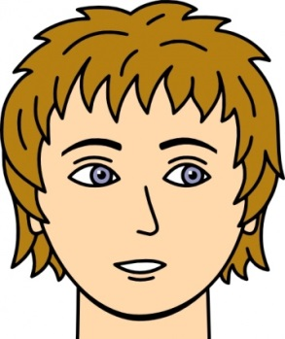


Types of Conflict
Party
Movies
Approach- Approach
Studying
Cleaning
Avoidance- Avoidance
Approach- Avoidance

Slide 17
Responses to Stress
Physical symptoms: dry mouth, excessive perspiration, frequent illnesses, gastrointestinal problems, grinding of teeth, headaches, high blood pressure, pounding heart, stiff neck, aching lower back
Emotional symptoms: anxiety or edginess, depression, fatigue, impulsiveness, inability to concentrate, irritability, trouble remembering things
Behavioral symptoms: crying, disrupted eating or sleeping habits, harsh treatment of others, problems communicating, social isolation, increased used of tobacco, alcohol or other drugs

Slide 18


Gender and Stress
Gender roles affect perception of and responses to stressors
Both sexes experience the fight-or-flight physiological response to stress
Women are more likely to respond behaviorally with a pattern of “tend-and-befriend”
Tend and befriend response refers to the fact that people often manage threats by caring for offspring and seeking social support in time of stress.
Gender differences may be partly tied to higher levels of the hormone imbalance in women

Slide 19
Past Experiences
Past experiences influence the cognitive evaluation of a potential stressor
Effective behavioral responses can overcome the effects of negative past experiences

Slide 20
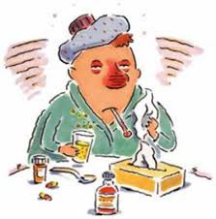
Stress & Health
Study has found that stress contributes to a person’s susceptibility to the common cold
Stress affects the immune system, making people vulnerable to disease
Some ailments & illnesses linked to stress
Heart disease
Lung ailments
Cirrhosis of liver
Suicide
High blood pressure
Headaches
Backaches

Slide 21
Coping

Slide 22
Coping
Process by which a person takes some action to manage environmental or internal demands that cause or might cause stress and that will tax the individual’s resources
Emotion focused - people try to manage their emotions in the face of stress
Problem focused - attempts to modify the stressful problem or source of stress
Avoidance oriented - involves cognitive and behavioral efforts oriented toward denying, minimizing, or otherwise avoiding dealing directly with stressful demands and is closely linked to distress and depression

Slide 23
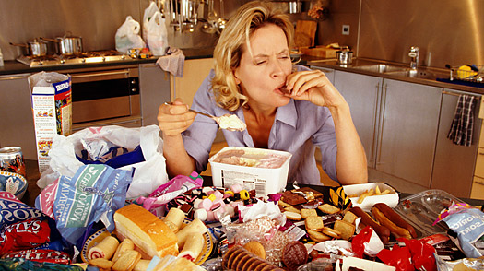
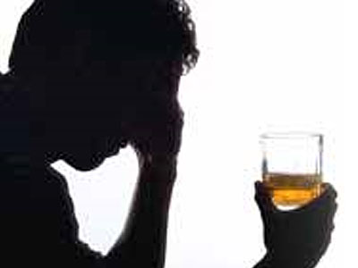

Counterproductive Coping Strategies
Tobacco
Alcohol
Other drugs
Binge eating

Slide 24
Coping with Stress
There are various coping strategies which can be used to reduce stress
The Multidimensional Coping Inventory (Endler & Parker, 1990) measures 3 major coping strategies
Task-Oriented Coping | Emotion-Oriented Coping | Avoidance-Oriented Coping
Outline priorities | Become very tense | Treat self to a favorite food or snack
Work to understand the problem | Blame self for being too emotional | Visit a friend
Think about the event & learn from mistakes | Fantasize about how things might turn out | Take time off & get away from the situation

Slide 25


Managing Stress
Exercise
Reduces anxiety and increases sense of well-being
Mobilizes energy resources to complete the energy cycle
Nutrition
Eat a balanced diet
Avoid excess caffeine

Slide 26
Managing Stress
Sleep
Lack of sleep is both a cause and an effect of excess stress
Social support
Foster friendships
Keep family ties strong
Get involved with a group
Communication
Balance anger and assertiveness

Slide 27
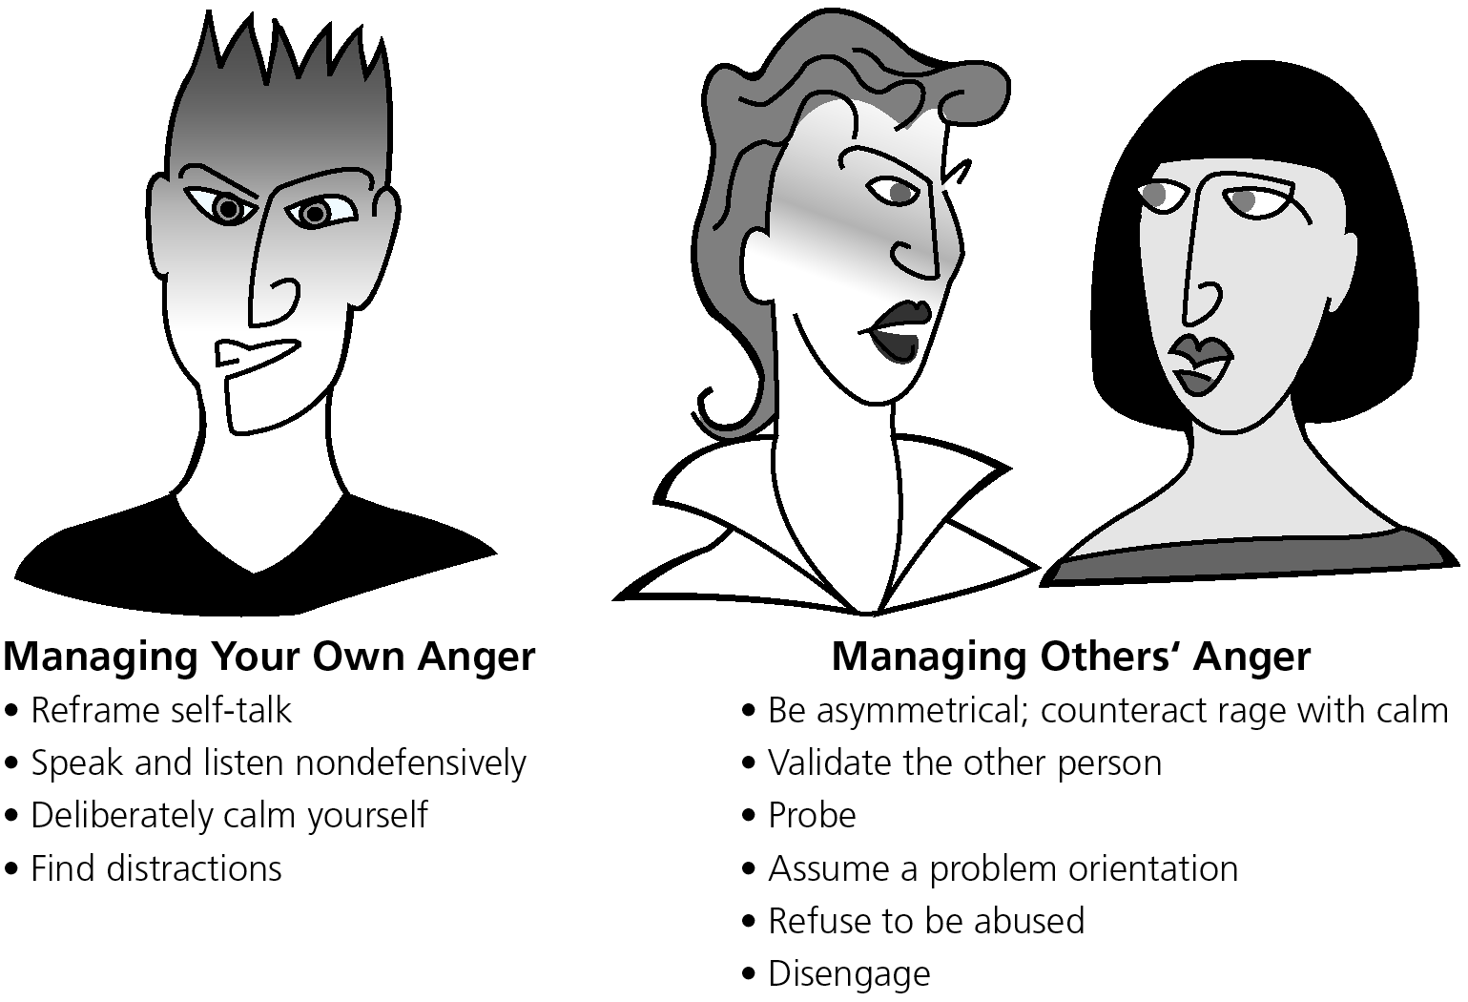
Managing Stress
Managing Anger

Slide 28
Managing Stress
Spirituality
Spiritual wellness can promote
Social support
Healthy habits
Positive attitude
Moments of relaxation
Awareness and clarification of personal values
Paths to spiritual wellness include organized religion, spending time in nature, helping others, art or other creative activities, personal relationships

Slide 29
Managing Stress: Time Management
Set priorities
Schedule tasks for peak efficiency
Set realistic goals
Budget enough time
Break up long-term goals
Visualize achievement of goals
Track tasks you put off
Do least favorite tasks first
Combine tasks
Identify in-between tasks
Hand over responsibility
Say no when necessary
Give yourself a break
Avoid personal time sinks
Just do it

Slide 30
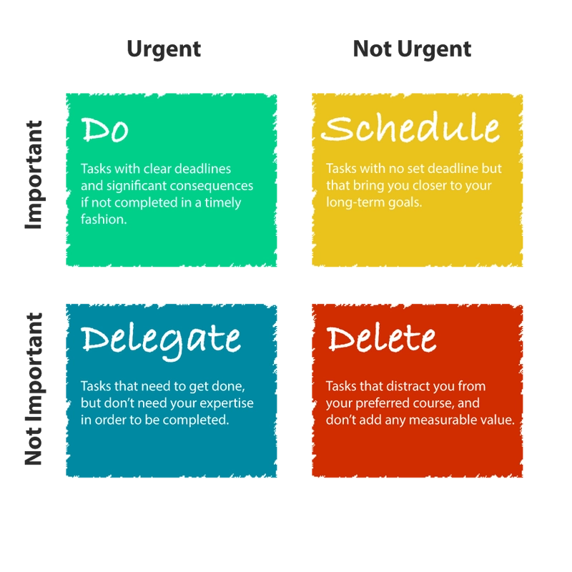
Time Management

Slide 31
Cognitive Errors and Stress
Cognitive Distortions: These are patterns of irrational thinking that can contribute to increased stress.
All-or-Nothing Thinking: This involves viewing situations in extreme, black-and-white terms. For example, if a student doesn't get a perfect score on a test, they may see themselves as a complete failure, even if they did well overall.
Catastrophizing: Catastrophizing is the tendency to imagine the worst possible outcome in any situation. For instance, if someone is running late for a meeting, they might envision a catastrophic outcome like losing their job.
Personalization: Personalization involves taking responsibility for events beyond one's control. For example, if a friend cancels plans, you might assume it's because they don't like you, even though they canceled due to their own reasons.

Slide 32
Cognitive Errors and Stress
Mind Reading: This distortion occurs when individuals believe they know what others are thinking and that it's negative. For example, if a coworker doesn't say "hello" in the morning, you might assume they're mad at you.
Filtering: Filtering is the practice of selectively focusing on negative aspects of a situation while ignoring the positive. For instance, someone might receive many compliments on a project, but they focus on the one piece of criticism.
How Cognitive Errors Contribute to Stress: Cognitive errors can intensify stress by distorting reality and amplifying negative emotions. They lead to increased anxiety, reduced self-esteem, and a sense of helplessness. Recognizing and challenging these distortions can help manage stress effectively.

Slide 33
Managing Stress: Cognitive Techniques
Modify expectations
Engage in realistic self-talk
Live in the present
“Go with the flow”
Cultivate your sense of humor

Slide 34
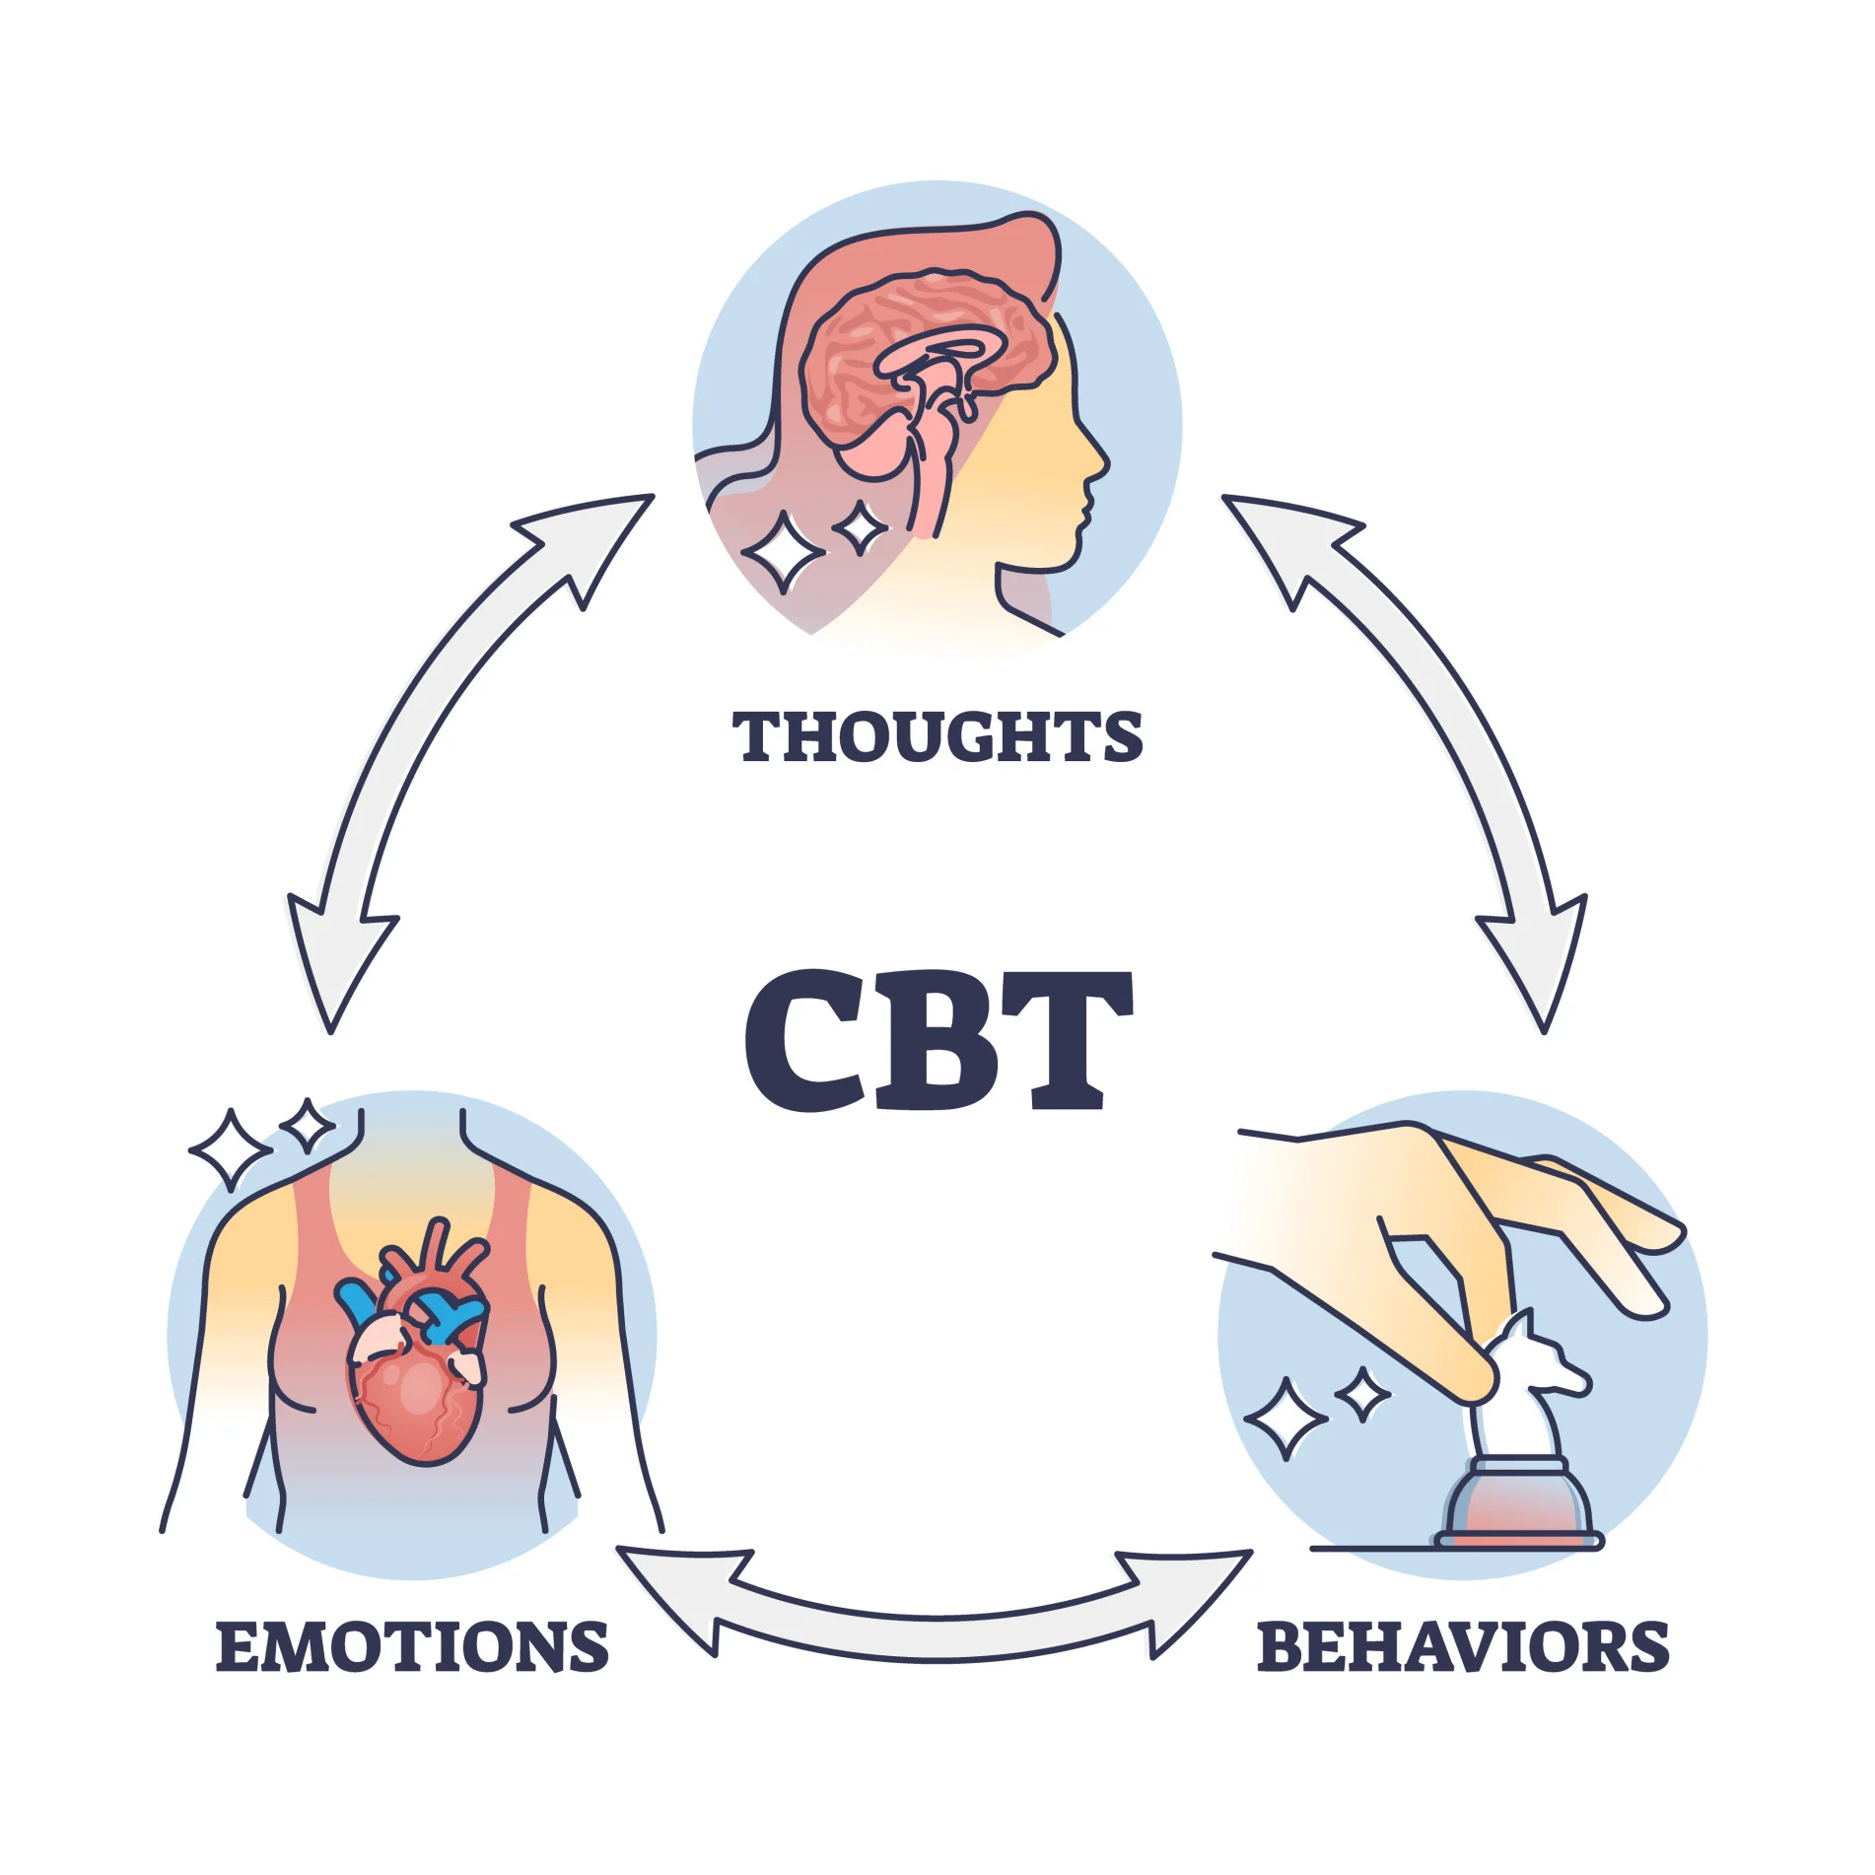

Slide 35
Managing Stress
Relaxation
Relaxation response
A physiological state characterized by a feeling of warmth and quiet mental alertness
Relaxation Techniques
Progressive relaxation : alternating muscle tension and relaxation
Visualization: creating or recreating vivid mental pictures of a place or an experience
Deep, slow breathing
Listening to music
Meditation: quieting the mind by focusing on a particular word, object, or process
Yoga: a series of physical postures emphasizing balance and breathing control

Slide 36
How to do deep breathing
First, take a normal breath. Then try a deep breath: Breathe in slowly through your nose, allowing your chest and lower belly to rise as you fill your lungs. Let your abdomen expand fully. Now breathe out slowly through your mouth (or your nose, if that feels more natural)

Slide 37
https://www.youtube.com/watch?v=QOgKutspaNY&list=RDQMC9K72qls76Q&index=2

Slide 38
Goal Setting
WOOP
WISH
OUTCOME
OBSTACLE
PLAN

Slide 39
Wish: Define your wish or goal.
Example: "I want to improve my physical fitness and lead a healthier lifestyle.“
Outcome: Imagine the best possible outcome
Imagine how your life would be if you achieved your fitness goal. Visualize the benefits, such as increased energy, better mood, and enhanced overall well-being.
Example: "If I improve my physical fitness, I will feel more energetic, be more confident, and have a lower risk of health issues. I'll be able to engage in activities I enjoy without feeling tired."

Slide 40
Obstacle: Identify the obstacles that might get in the way
Recognize and list the potential obstacles that could hinder your progress. These could be lack of time, unhealthy eating habits, or a sedentary lifestyle.
Example: "Possible obstacles include a busy work schedule, cravings for unhealthy snacks, and the temptation to skip workouts."

Slide 41
Plan: Develop a specific plan to overcome the obstacles
Create a detailed plan that addresses each obstacle. Be specific about how you will overcome challenges.
Example:
Obstacle 1 (Busy Work Schedule): Schedule specific workout times in my calendar, treating them as non-negotiable appointments.
Obstacle 2 (Unhealthy Snacking): Replace unhealthy snacks with healthier alternatives like fruits or nuts, and keep them readily available.
Obstacle 3 (Skipping Workouts): Find a workout buddy for mutual motivation, or try enjoyable activities like dance classes or sports to make exercise more engaging.

Slide 42
Managing Stress
Getting Help
Peer counseling and support groups
Professional help
Is it stress or something more serious?
Depression = a mood disorder characterized by loss of interest in usual activities, sadness, hopelessness, loss appetite, disturbed sleep, and other physical symptoms
Severe depression is linked to suicide

